Slide 1
Please write your field of dissertation on the blank sheet

Slide 2
Cancer: Genes and pathways

Slide 3
Cancer: A genetic disease
Three main responsible genes:
  Oncogenes
  Tumor-suppressor genes
  Stability genes
Mutation in single gene can cause the disease but can’t cause the cancer.
Cancer cause due to multiple defective genes.
If germline mutation in above genes then predispositions to Cancer and if in somatic then sporadic tumors.
The most common mutations, in germline, are subtle (point mutations or small deletions or insertions), whereas all types of mutation can be found in tumor cells.

Slide 4
How Proto-Oncogenes Become Oncogenes
Point mutations, deletions, or insertions that lead to a hyperactive gene product
Point mutations, deletions, or insertions in the promoter region of a proto-oncogene that lead to increased transcription
Gene amplification events leading to extra chromosomal copies of a proto-oncogene
Chromosomal translocation events that relocate a proto-oncogene to a new chromosomal site that leads to higher expression
Chromosomal translocations that lead to a fusion between a proto-oncogene and a second gene, which produces a fusion protein with oncogenic activity

Slide 5
Oncogene activations
Defective gene formation due to:
  Chromosomal translocations
  Gene amplifications
  Subtle intragenic mutations

Slide 6
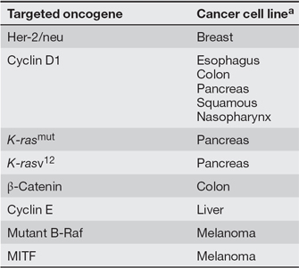
Involved Genes in different cancer
valine to a glutamate: activates the enzyme even in the absence of signals
Note: In case of Sickle-cell disease Glu replace with Val.

Slide 7
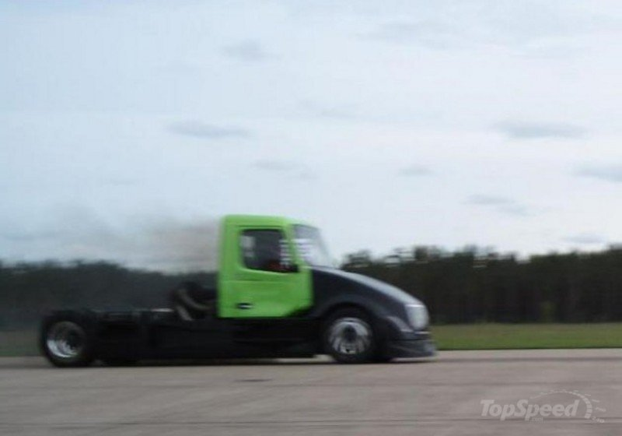
A mutation in an oncogene is analogous to a stuck accelerator in an vehicle

Slide 8
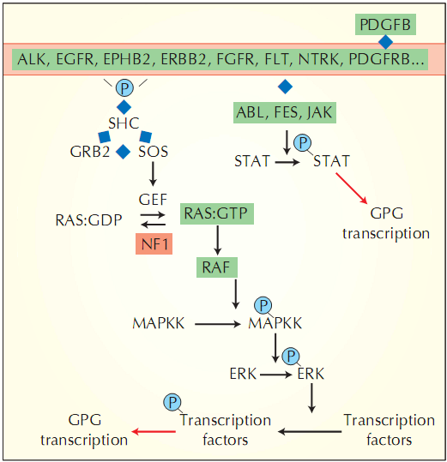
Pathways involve
Red box: Germline Mutation in gene
Green Box: Somatic mutation in gene
Diamonds: P-P interaction
Red arrow: Transcriptional induciton
GPG: growth-promoting-gene

Slide 9
Tumor-suppressor genes
Mutation involves in declivity of gene activity by following methods:
  Missense mutations at residues that are essential for its activity
  Mutations that result in a truncated protein
  Deletions or insertions of various sizes
  Epigenetic silencing.

Slide 10
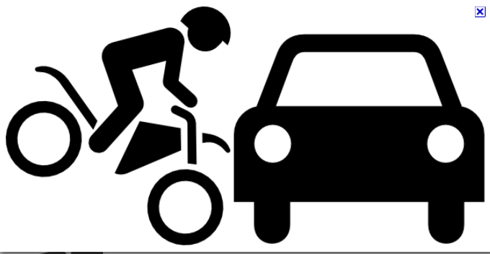
mutation in a tumor-suppressor gene is analogous to a dysfunctional brake in an automobile

Slide 11
Oncogene and tumor-suppressor gene mutations: coordinated function
Force the NEOPLASTIC process by:
  Increasing tumor cell number through the stimulation of cell birth.
  Inhibition of cell death or cell-cycle arrest.
  The increase can be caused by activating genes that drive the cell cycle.
  Inhibiting normal apoptotic processes.
  Facilitating the provision of nutrients through enhanced angiogenesis.

Slide 12
Stability Genes or Caretakers
Promotes tumorigenesis due to mutation in following genes:
  Mismatch repair (MMR) gene
  Nucleotide-excision repair (NER) gene
  Base-excision repair (BER) gene
(genes responsible for repairing subtle mistakes made during normal DNA replication or induced by exposure to mutagens)

Slide 13
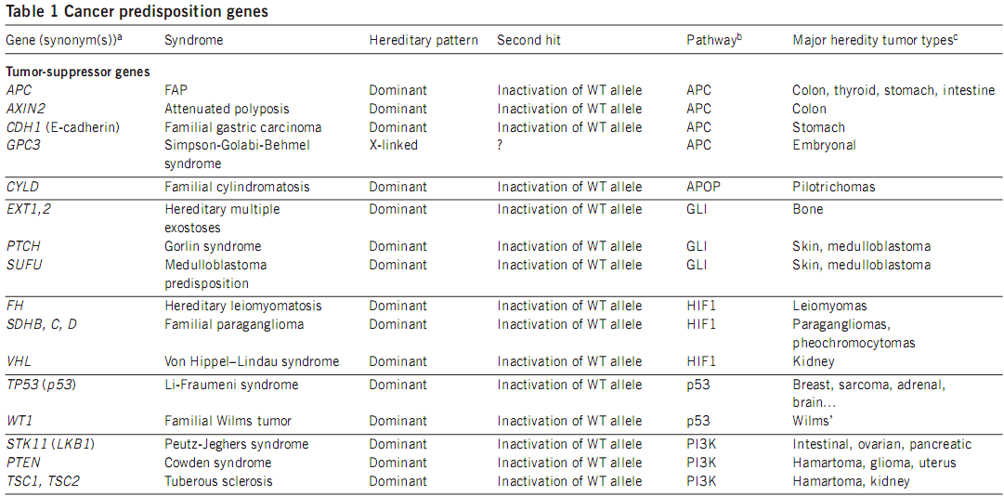
Tumor-suppressor Genes

Slide 14
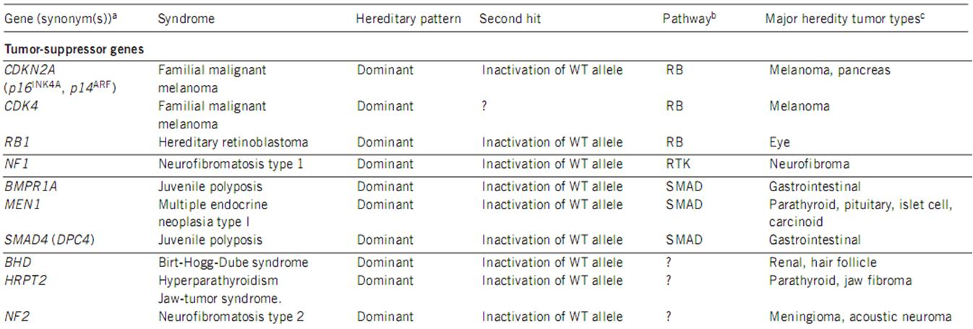
Tumor-suppressor Genes

Slide 15
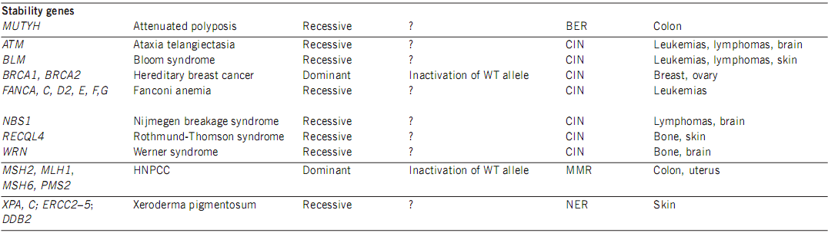
Stability Genes

Slide 16
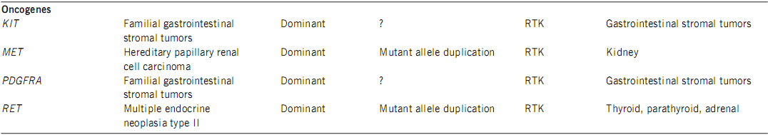
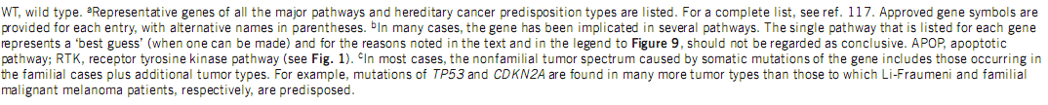
Oncogenes

Slide 17
Involved Genes

Slide 18
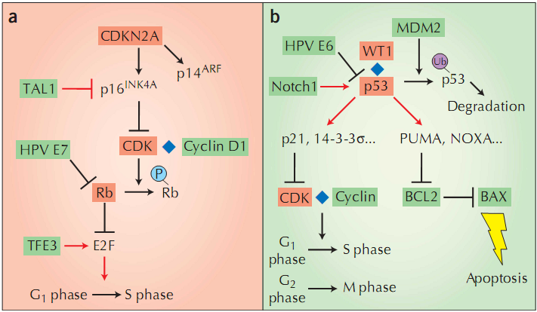
Rb and p53 pathway
Red box: Germline Mutation in gene
Green Box: Somatic mutation in gene
Diamonds: P-P interaction
Red arrow: Transcriptional induciton
T-bars indicate: Transcriptional repression

Slide 19
Tumors
Solid Tumor
Liquid Tumor
Epithelial or mesenchymal cells that normally are immobile.
Leukemias and lymphomas, composed of neoplastic cells whose precursors are normally mobile
Other differences
Three mutations seem to be required to develop a malignant solid tumor in adults
chromosome translocations are much less common in solid tumors
Only one or two mutations may be required to develop a malignant liquid tumor
Oncogene activations caused by chromosome translocation events are the most common genetic alterations observed in liquid tumors
Inactivations of tumor-suppressor genes are ubiquitious

Slide 20
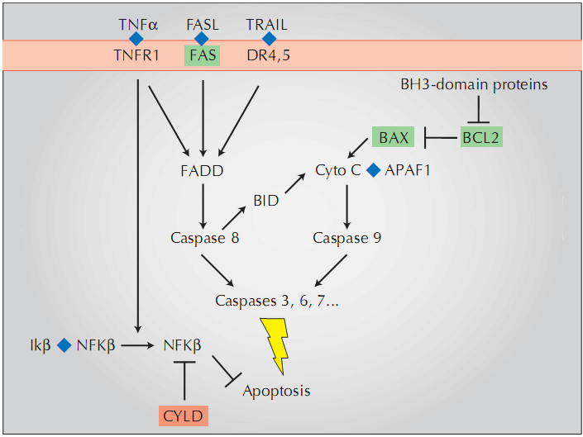
Apoptosis Pathway

Slide 21
Question ??

